Slide 1
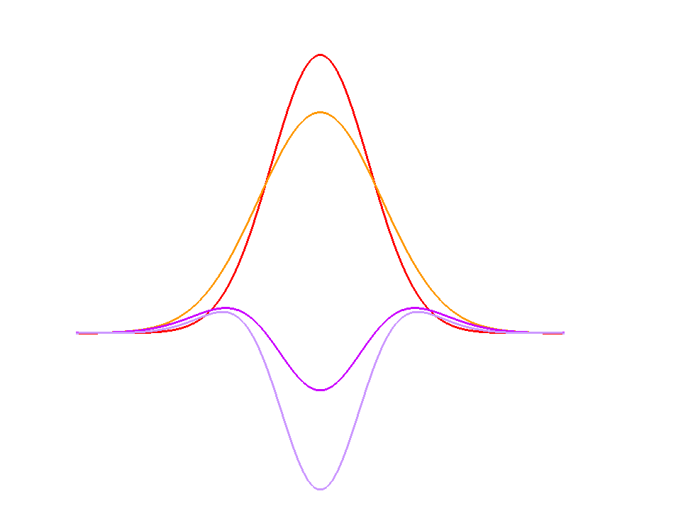
Laplacian of Gaussian approximation
⬧ = 1.0
k = 1.26
LoG approximation (G_{k} - G)
LoG

Slide 2
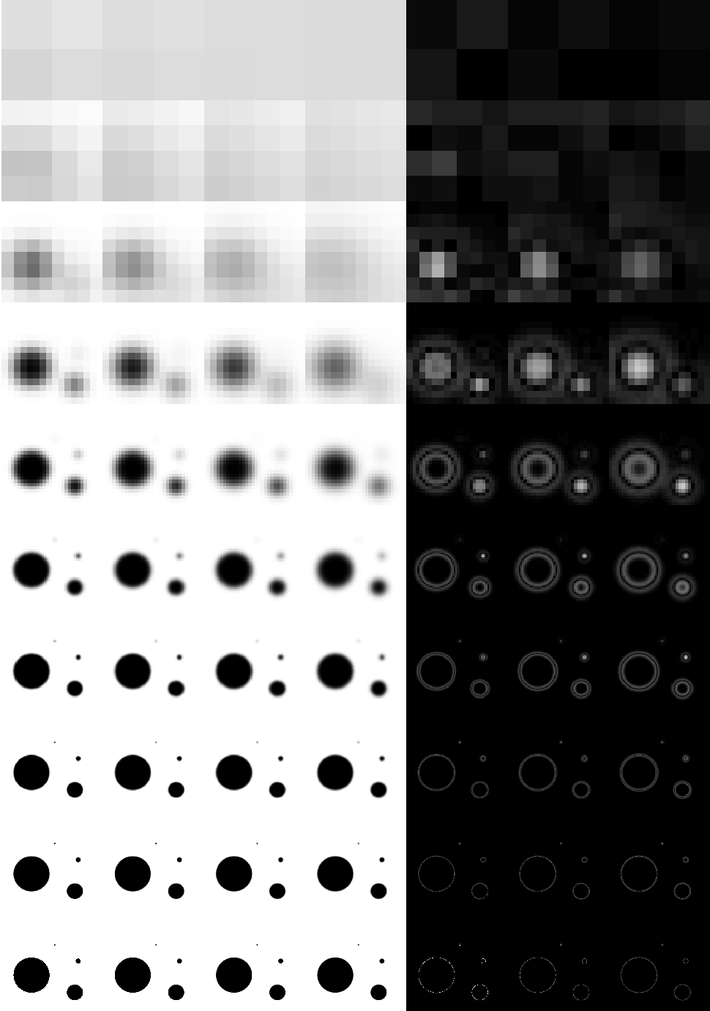
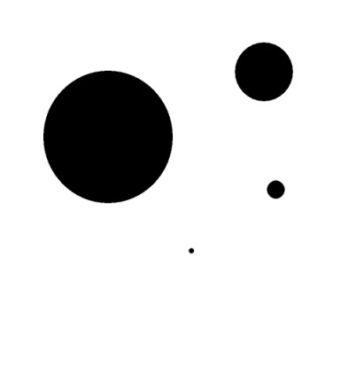
Laplacian of Gaussian approximation
Image pyramid
(10 octaves)
subsampling
Original image
-
=
First “octave”:
4 successive blurred image
3 corresponding DoG

Slide 3
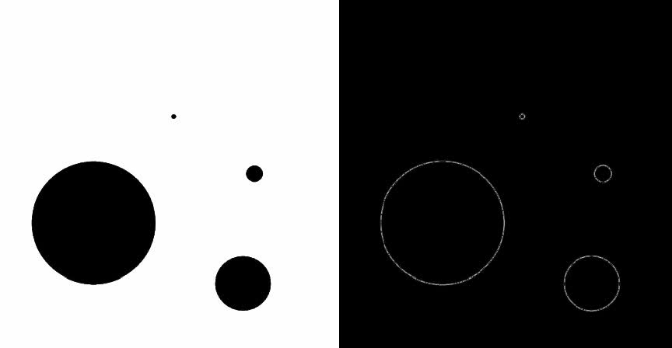
Image pyramid visualisation
Linearly interpolated and absolute value (for visualisation purpose)

Slide 4
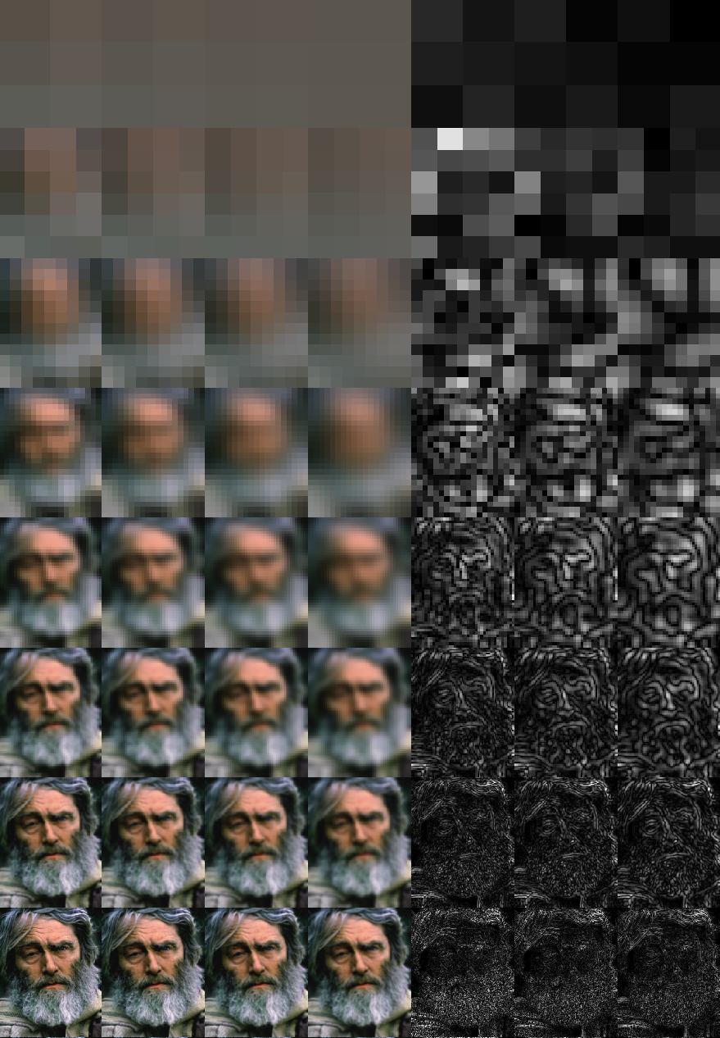
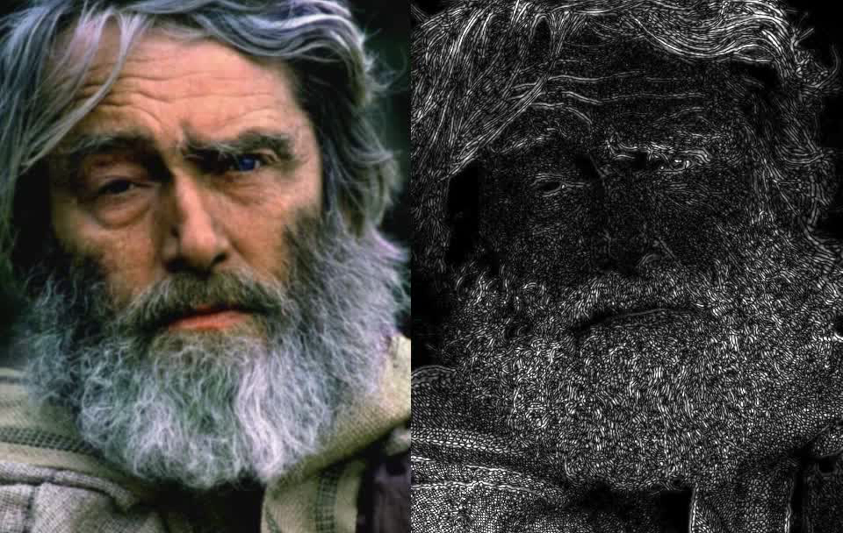
Other example
Linearly interpolated and absolute value (for visualisation purpose)

Slide 5
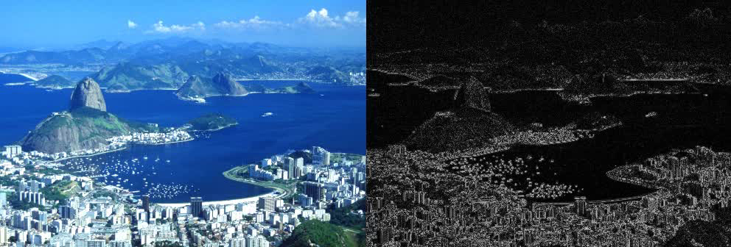
Other example
Linearly interpolated and absolute value (for visualisation purpose)

